Slide 1

Week 6 Linear Algebra
By
Mr. Farhan Ali
farhan.ali@bnu.edu.pk
Beaconhouse National University, Lahore

Slide 2



Slide 3

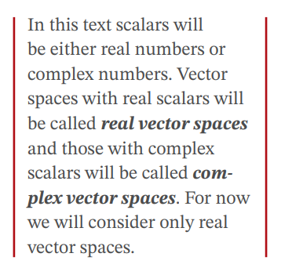

Slide 4
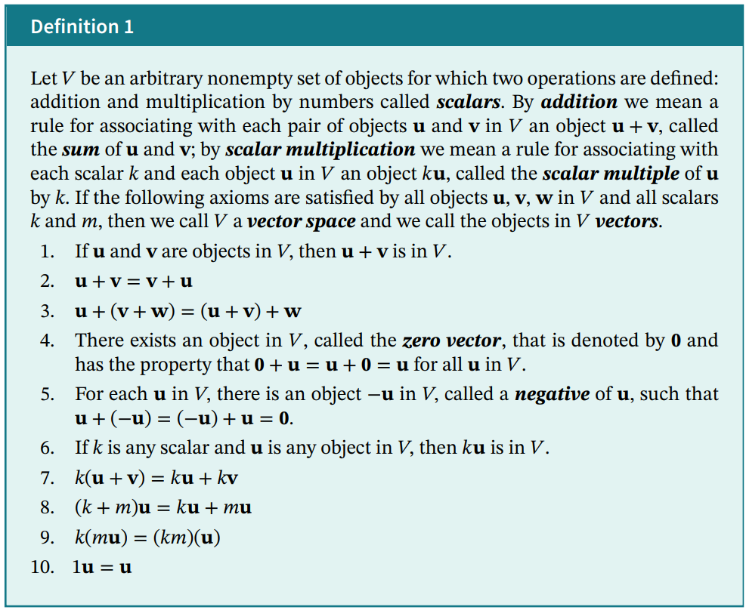

Slide 5


Slide 6


Slide 7
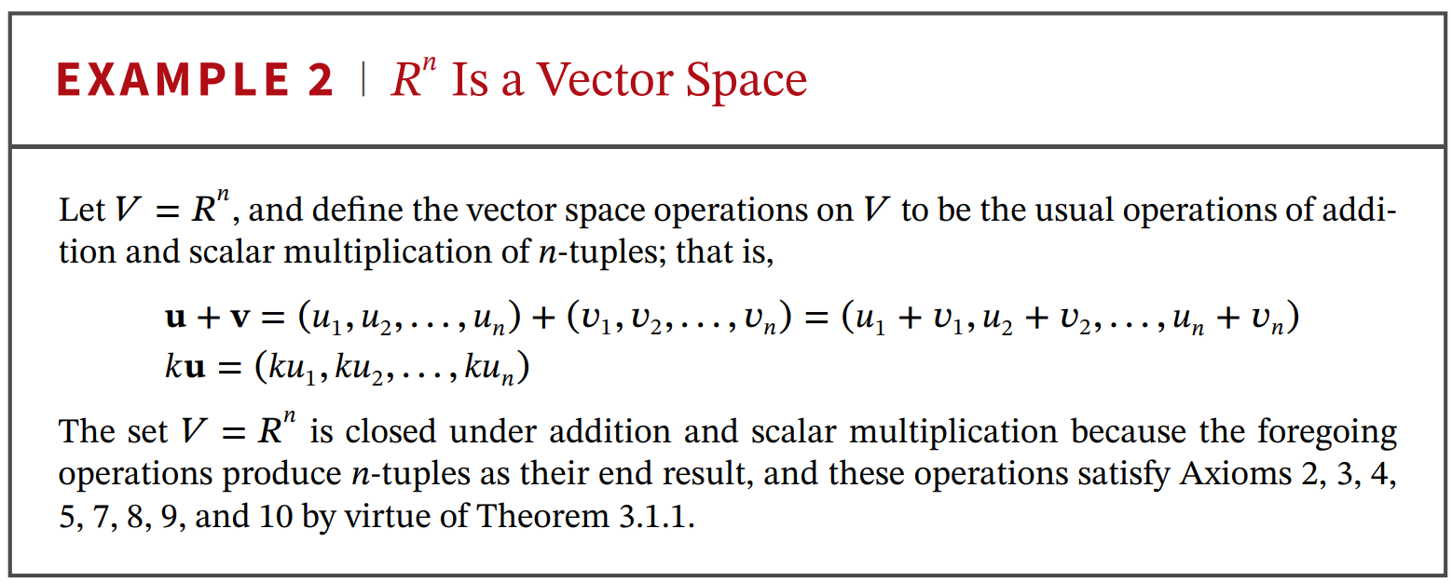

Slide 8
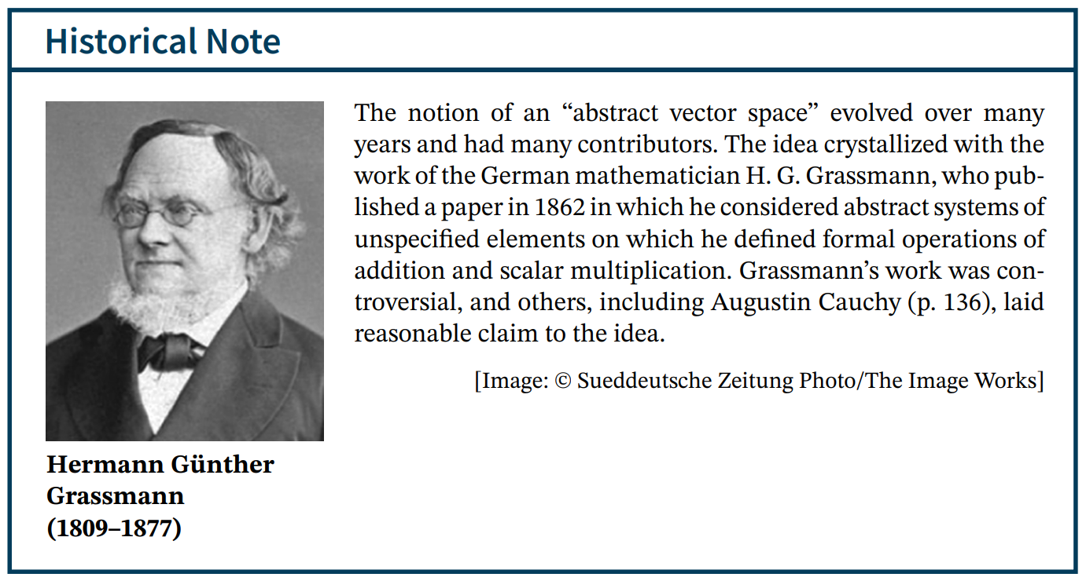

Slide 9
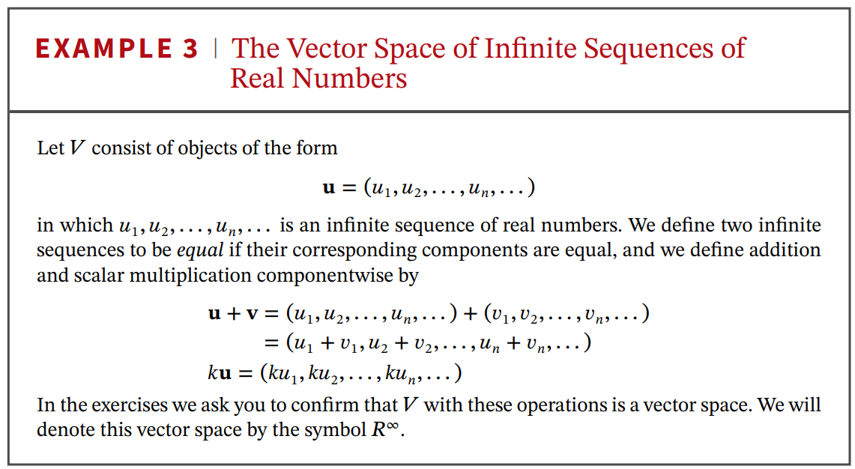

Slide 10
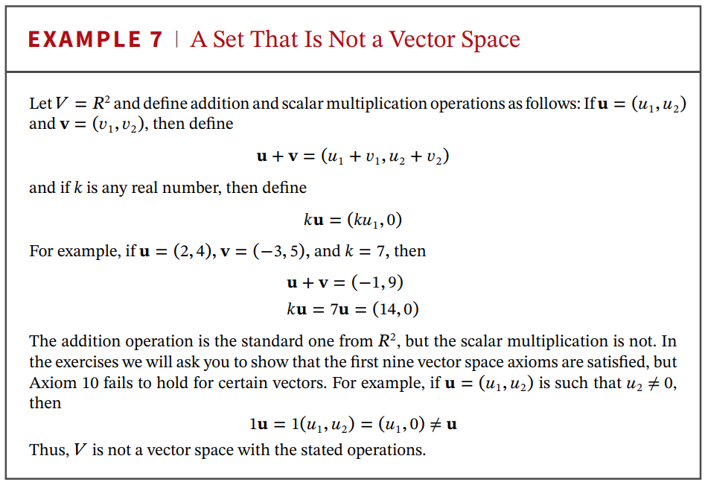

Slide 11
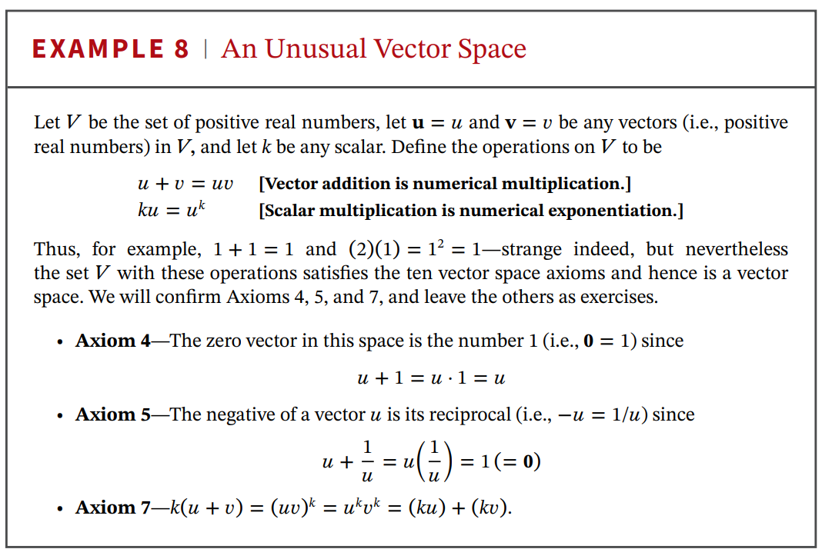

Slide 12


Slide 13
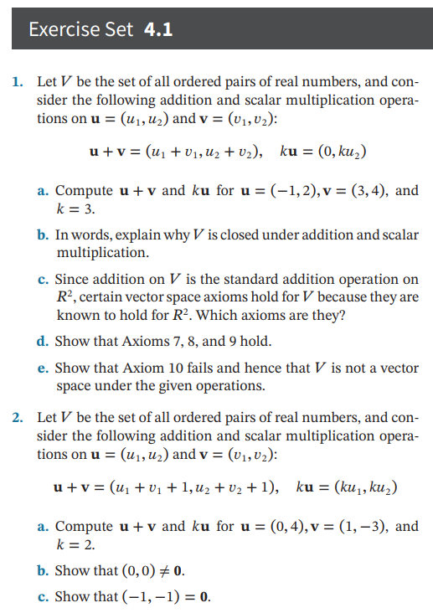

Slide 14



Slide 15


Slide 16
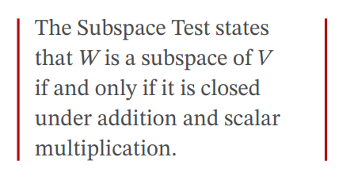


Slide 18
Thank You

